Slide 1
Optimization of Production from Oguta Field
Charter Template
Business Case/objectives:
Oguta wells flow to Oguta flow station which is a double bank station of nominal capacity of 60kbbpd. XHP and XXHP wells of Oguta provide feed gas to Oguta gas plant for injection into F3.0A reservoir. Gas compressor plant was decommissioned in 2016 and as a result HGOR wells were shut-in for gas flaring control and reservoir energy management.
Current field IPSC is 1400bopd from 3 wells (5S, 13T and 24T) and 13T was found to have ZERO CITHP early 2018 and still under troubleshooting for restoration.
There are opportunities to produce some of the closed in wells due to HGOR on lower bean size and also open up some non HGOR wells that were closed in long time ago.
This cadence is to harness all the opportunities from Oguta 13T(620bopd), 17L(210bopd), 26T(300bopd), 1L(300bopd) & 6L(200bopd).
Potential Benefits & Measurement:
Increase Oguta field IPSC by 1600bopd
Increase production from Oguta field by 1600bopd
To checkmate further reduction of wellhead equipment theft/vandalization
To improve PU DUOC by increasing revenue generation.
Project Scope/Actions :
Carry out further review and firm up candidates
Carry out Nitrogen lift of 13T if required
Scope wellhead equipment requirements
Carry out FL integrity check/FL replacement
Retrieve NRV/downhole plug where applicable
Install wellhead equipment
Open up well on agreed bean size
Test and evaluate the potential/oil gain
Critical Success Factors:
Leadership support
Budget approval
Cross-function collaboration
Timely delivery
FTO
  Project Sponsor: Wilcox Emmanuel/Aniemeke Sam
  Implementation Lead: Adenuga Olufemi/Nwalozie Collins
  Project Team: Nwalozie Collins, Adenuga Olufemi, Nna-Okpabi John, Oboro Richardson, Buwa Sam, Aroh Sylvester, Amaraizu Odoemelam, Gloria Erivona, Asset engineering rep (TBA), CWI Engineer (TBA)
High-level Timeline:
L0-L1 Idea being turned into initiative 25TH July 2018
L2: Develop implementation plan and firm up candidates 27th July 2018
L3: Secure management approval and budget 15th August 2018
L4: Commence Implementation 20th August 2018
L5: Evaluate project benefits and document learnings 10th November 2018
Initiative End 15th November 2018

Slide 2
Bi-Weekly Cadence Commitment Template Past 7 days
No. | Action | Action Party | Threath | Due Date | Status
1 | Develop implementation plan and communicate to project team |  |  | 30/07/18 | Ongoing
New
On track
At risk
Delayed
Completed

Slide 3
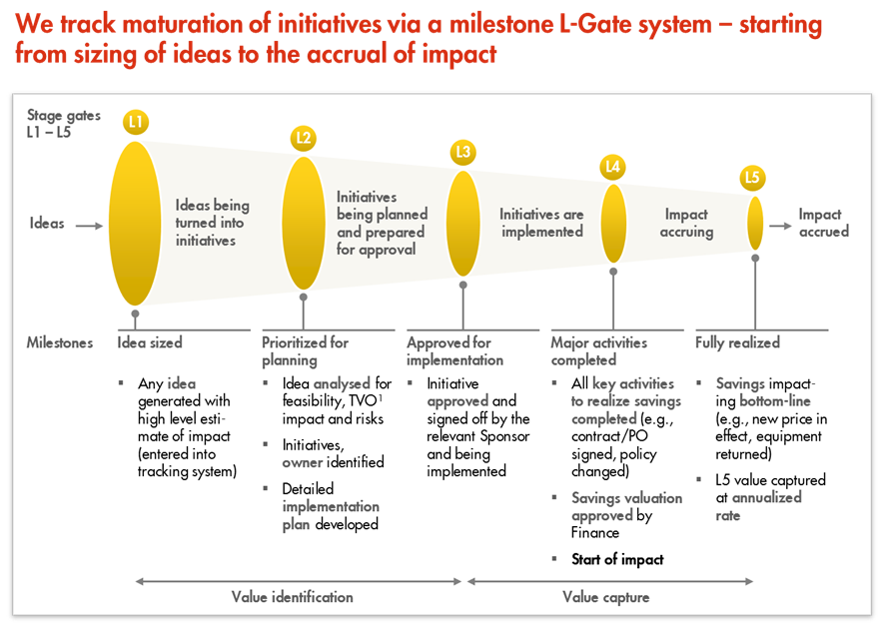
L1 – L5 Gates

